Slide 1
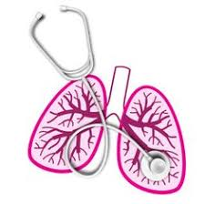
University of Basrah Al-zahraa medical college
Ministry of higher Education and Scientific Researches
MODULE: The Respiratory System
STUDY SESSION: 5
DURATION: 2hrs
Chemical control of breathing
Module staff:
Dr. Hadeel S. Al Ali Dr. Kadhum Salih
Dr. Aamir Qasim Dr. Majid Hameed
Dr. Firas Muhammed Dr. Luma Ahmed
Dr. Ihsan Mardan Dr. Nawal Mustafa
Guyton, A.C., Human Physiology and Mechanisms of Disease, 13th Edition, W.B. Saunders, 2016, ISBN: 978-1-4557-7005-2.
Koeppen, B.M. & Stanton, B.A. Berne & Levy: Principles of Physiology, 7th Edition, Philadelphia, PA, 2018, ISBN: 978-0-323-39394-2.
For more discussion, questions or cases need help please post to the session group

Slide 2
A patient presents to you with the following arterial blood chemistry: pCO₂ 6.3kPa, pH 7.34. Use the Henderson Hasselbalch equation to calculate the concentration of hydrogen carbonate ions in her plasma. What is this disturbance of acid base balance called?

Slide 3
You return to the same patient 3 days later, her pCO₂ is still 6.3kPa, but the new plasma pH is 7.4. What has changed and why? What do we call this change in acid base balance?

Slide 4
A young man is seen in casualty with acute pneumonia. There is poor ventilation of part of his lung due to an acute inflammatory exudate filling the affected alveoli. Indicate the likely changes in pO₂ & pCO₂ in the alveolar gas & blood draining the affected & non affected alveoli.
Choose from following options to complete appropriate boxes & alveoli in the diagram:-
Normal (^{à}) Increased (↑) decreased (↓)

Slide 5
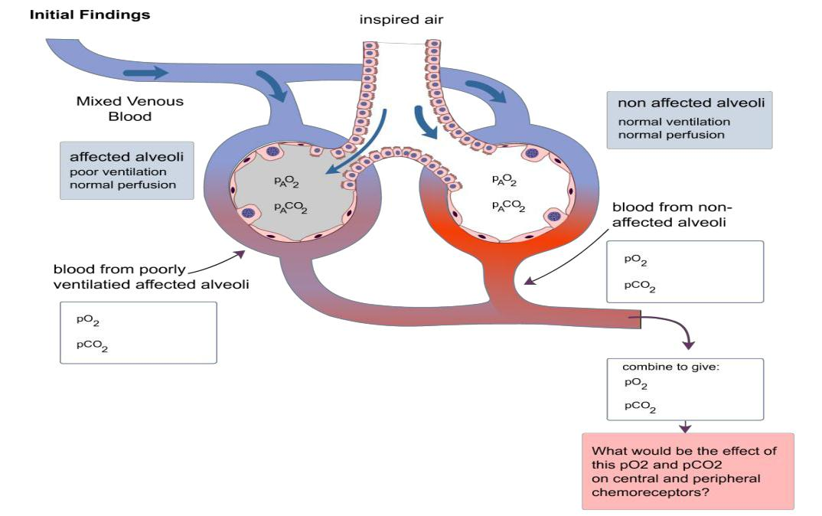

Slide 6
Next consider the response of the respiratory system to the above changes in pO₂ & PCO₂. Then complete the following diagram to show the final effect on pO₂ & PCO₂ in this patient.

Slide 7
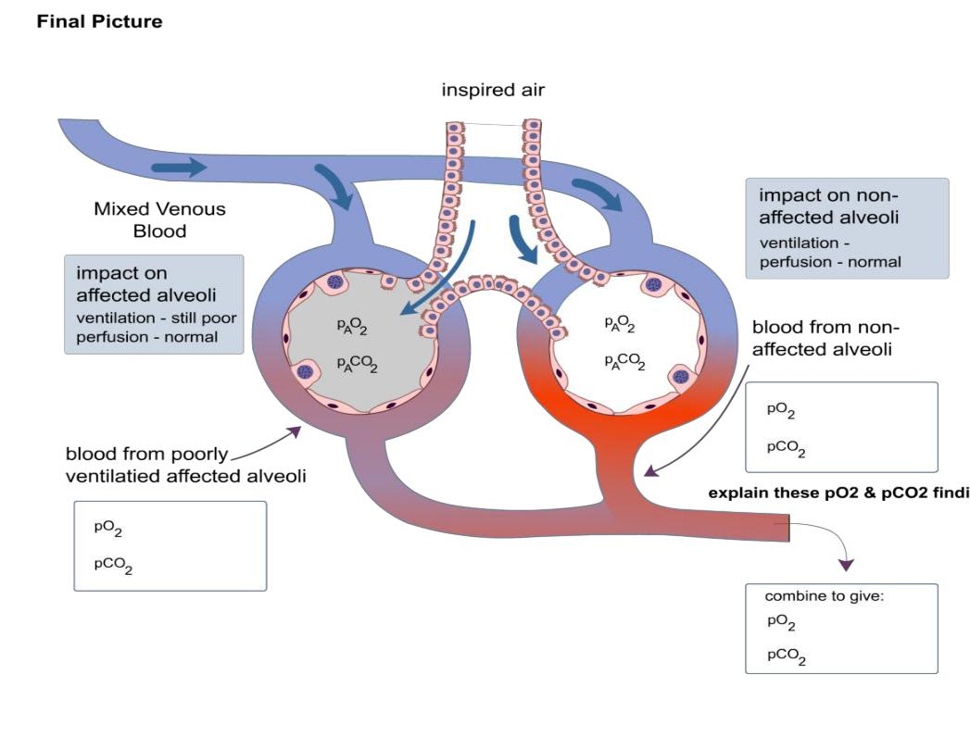

Slide 8
A young man appears in casualty. You note that his respiration is rapid and quite deep, and suspect that he is anxious and hyperventilating. When you measure his blood gases you find a pCO₂ of 4.3kPa, and a plasma pH of 7.2. Is your initial suspicion correct?

Slide 9
If not, what might account for the symptoms? How would your view change if you learned that he had been feeling very tired lately and seemed far more thirsty. What other investigation would you perform?

Slide 10
A young woman is carried out of a club semi-conscious and twitching. She has not been drinking or taking any other drugs. Her respiration is deep and rapid.
A medical student in her group notes that she has ‘tetany’ what do you think may have happened? How would you treat her?

Slide 11
Sketch a graph of the relationship between pCO₂ and pH for normal blood. Plot pH on the vertical axis (ordinate) and pCO₂ (in kPa) on the horizontal axis (abscissa). Indicate on the graph the status of a normal individual in normal.
acid base balance who is breathing normally. (Hint – start by plotting the normal pH & normal pCO₂).

Slide 12
Indicate on your graph above, the status of an individual who has been (i) hyperventilating for a few minutes (ii) hypoventilating for a few minutes.

Slide 13
How will the graph change if the concentration of buffer base (mainly HCO₃⁻) changes in the subject’s blood? Sketch new lines on the same graph above for a subject who has (i) a metabolic acidosis (ii) a metabolic alkalosis

Slide 14
Re-draw the 3 curves you have constructed above. Indicate what will happen to the pCO₂, pH, and buffer line of a subject's blood over 3 days of mild hypoventilation. (i.e. the process of renal compensation of a respiratory acidosis).

Slide 15
Respiratory diseases which cause reduced ventilation of the lungs as a whole lead to both hypoxia and hypercapnia. What effect will the hypercapnia have on the urge to breathe?
(Note: the subject will not be able to increase his/her tidal volume enough to restore normocapnia because of the disease)

Slide 16
What will happen to the urge to breathe over time if the hypercapnia persists? Why?

Slide 17
In the normal individual breathing is 'driven' by carbon dioxide. Which partial pressure do you think is most important in a subject with long term hypercapnia and hypoxia?

Slide 18
What might happen to such a subject if you give them oxygen to breathe?
(Note: this becomes important when treating patients with chronic obstructive pulmonary disease, who have both hypercapnia and hypoxia, as you will see later).

